Slide 1

Software Engineering
Testing and Continuous Integration
Harald Drillenburg
Year 2 2nd term

Slide 2

Course structure
Principles of Software Engineering
The zen of project planning
Developing under architecture
Designing with patterns
Testing and continuous integration
Test Driven Development
Architecture in Agile projects
Year 2 2nd term

Slide 3



Questions during class!
Jaar 2 Kwartaal 1

Slide 4
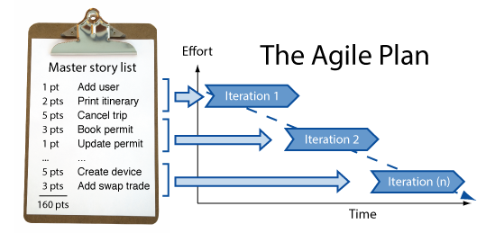

Discussion: project plan for EPD
Year 2 2nd term

Slide 5
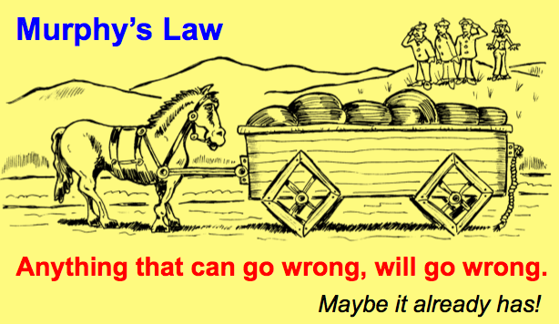
Meet Murphy
Year 2 2nd term

Slide 6

Meet Murphy
Year 2 2nd term

Slide 7
Quality Control
Compiling is necessary, but no proof it works ok
Putting the code to the test is essential
But you cannot ‘test the quality into the code’
  If the structure is bad, no amount of tweaking will rectify that
Year 2 2nd term

Slide 8
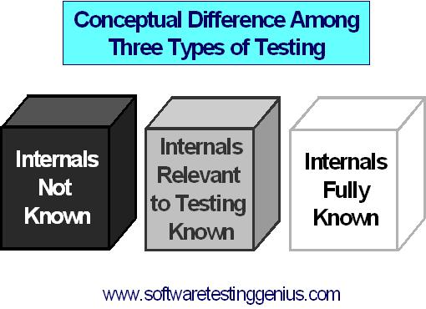
Types of testing
Black box
Grey box
White box
Year 2 2nd term

Slide 9
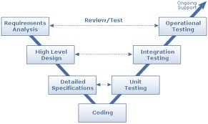
Development versus testing
Year 2 2nd term

Slide 10
Types of testing
Developer’s tests
  Unit test
  Integration test
System tests
Acceptation tests
  Functional acceptation tests
  User testing
Year 2 2nd term

Slide 11
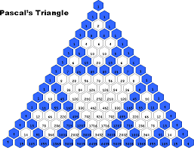
Assignment
Take the project ‘Pascal Driehoek’ from blackboard
Test this project to either show it works well or to find the error(s)
Discussion: how did this work?
Year 2 2nd term

Slide 12

Assignment
Take the project ‘Universe Simulation V2.0’ from blackboard
There seems to be an error somewhere in this code. Test the code to find it
Discussion: what’s the problem here?
Year 2 2nd term

Slide 13
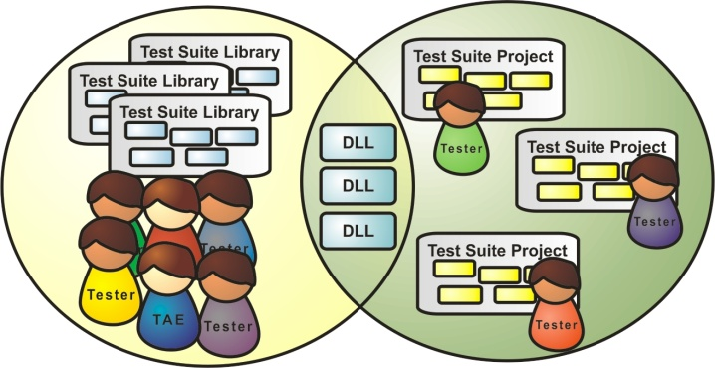
Test framework: the principle
Structured tests in separate structure
Reuse of pre-built components
Reuse of tests already developed
Test suite comprised of tests
  Giving statistics such as code coverage
No test result interpretation by looking at output
Year 2 2nd term

Slide 14

Test framework: JUnit
A semi-complete application solely aimed at providing testing functionality
Provides the plumbing for testing
Frees the developer from manually checking test results
Enables reuse of tests and structured regression testing
Year 2 2nd term

Slide 15
Configuring JUnit
One library needed
  Downloadable from http://www.junit.org/
  In Eclipse, JUnit is already in the build path and classpath
  We will run our tests from Eclipse
Annotations are used to direct the framework
Year 2 2nd term

Slide 16
Writing simple tests -> the class
public class Location {
private long x;
private long y;
…
public long getDistance(Location other) {
return (long) Math.sqrt(Math.pow((this.x - other.x), 2) + Math.pow(this.y - other.y, 2));
}
Year 2 2nd term

Slide 17
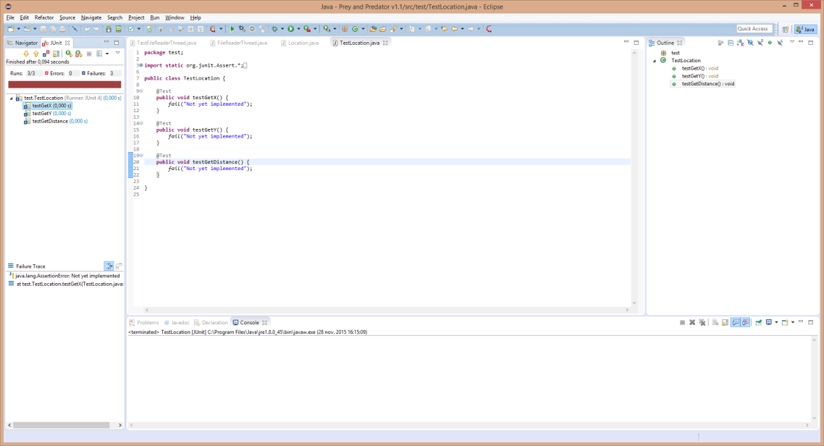
Writing simple tests -> teststubs
import static org.junit.Assert.*;
import org.junit.Test;
public class TestLocation {
@Test
public void testGetX() {
fail("Not yet implemented");
}
@Test
public void testGetY() {
fail("Not yet implemented");
}
@Test
public void testGetDistance() {
fail("Not yet implemented");
}
Year 2 2nd term

Slide 18
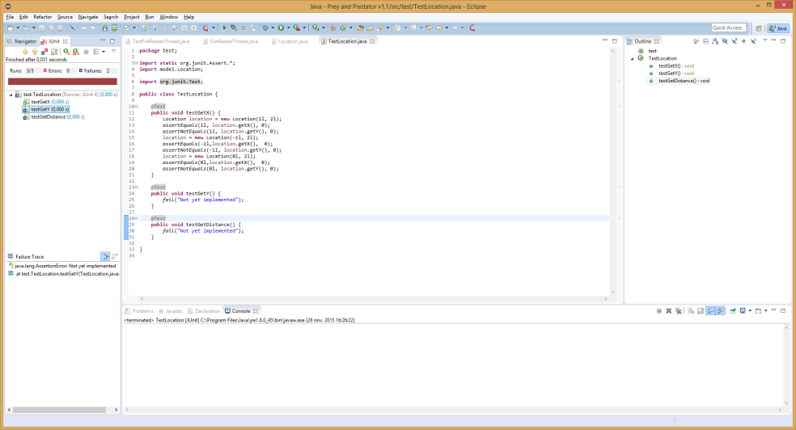
Writing simple tests -> asserts
public class TestLocation {
@Test
public void testGetX() {
Location location = new Location(1l, 2l);
assertEquals(1l, location.getX(), 0);
assertNotEquals(1l, location.getY(), 0);
location = new Location(-1l, 2l);
assertEquals(-1l,location.getX(), 0);
assertNotEquals(-1l, location.getY(), 0);
location = new Location(0l, 2l);
assertEquals(0l,location.getX(), 0);
assertNotEquals(0l, location.getY(), 0);
}
Year 2 2nd term

Slide 19
Initializing test situations
@Before
public void initializeLocations() {
locationMinusX = new Location(-1l, 1);
locationzeroX = new Location(0l, -1);
locationPlusX = new Location(1l, 0);
}
@Test
public void testGetX() {
assertEquals(1l, locationPlusX.getX(), 0);
assertNotEquals(1l, locationPlusX.getY(), 0);
assertEquals(-1l,locationMinusX.getX(), 0);
assertNotEquals(-1l, locationMinusX.getY(), 0);
assertEquals(0l,locationzeroX.getX(), 0);
assertNotEquals(0l, locationzeroX.getY(), 0);
}
Year 2 2nd term

Slide 20
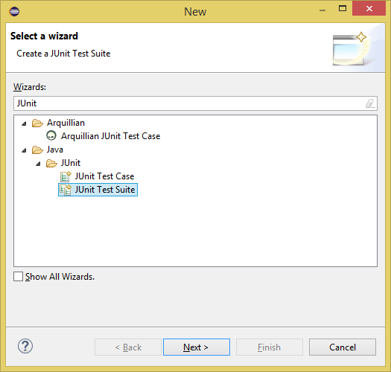
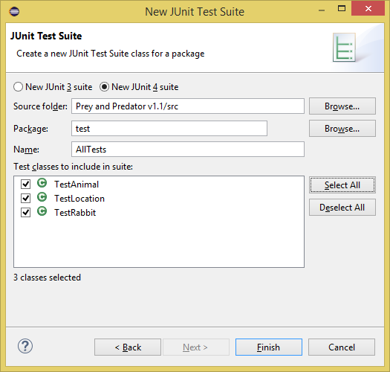
Building a test suite
A collection of tests run together
Allows for light, medium or heavy testing
Just as with test cases, Eclipse supports this by generating the stub code
Year 2 2nd term

Slide 21

Assignment
You wrote a whole bunch of proofs of concepts for design patterns and compound patterns
Write Junit test scripts and test suites for all of those!
Year 2 2nd term

Slide 22
Junit Extensions
JUnit in itself only usable for plain Java
Extensions were developed to remedy this
  HtmlUnit for Web Applications – Client side
  Cactus for the server side of Web Applications
  Selenium for integrated Web Application testing
  DBUnit to test database-based Java applications
  …..
Year 2 2nd term

Slide 23

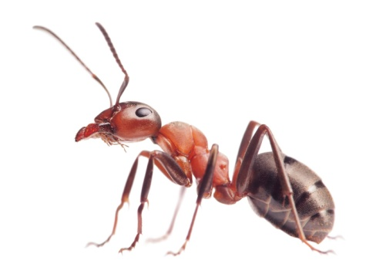
Build Tools
Compiling works different in a large project
Challenges with:
  Libraries
  Configurations
  Version control
Solution: build tools
  Ant
  Maven
  ….
Year 2 2nd term

Slide 24
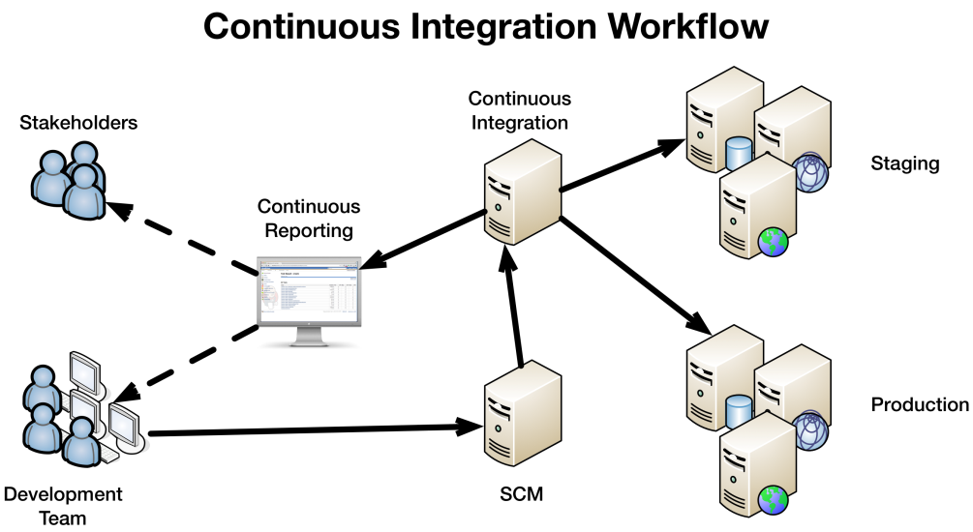
Continuous Integration
Combining a build tool and a testing framework
Runs the tests every time someone checks in
  Heavy tests can be postponed to (for example) once a day
Automatic reporting
Year 2 2nd term

Slide 25
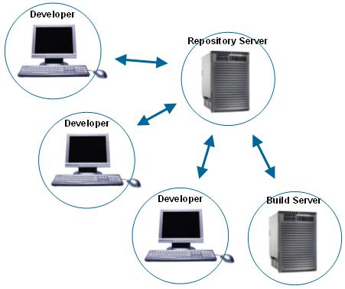
CI Tooling and Suits
Lots of tools available
Tool should fit the kind of development
Examples of tools:
  CruiseControl
  Hudson
Year 2 2nd term

Slide 26
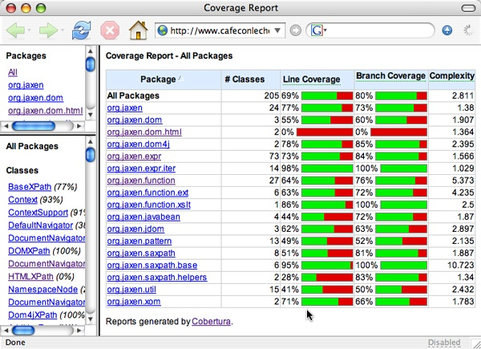
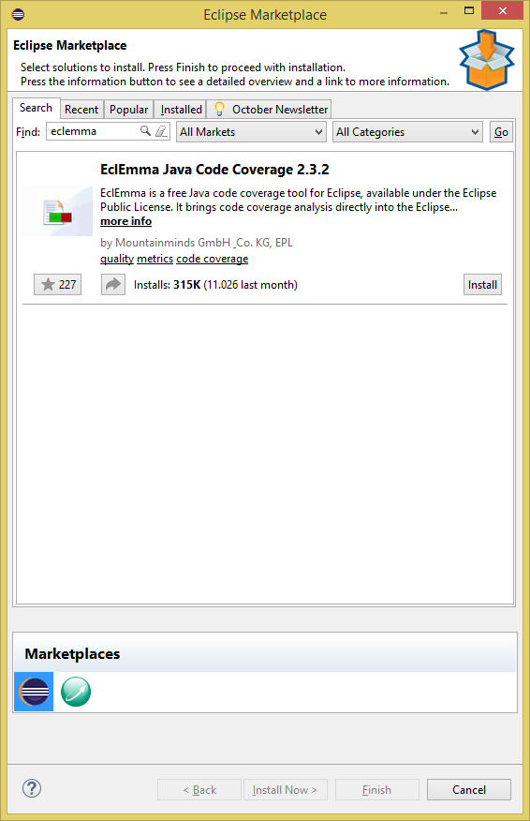
Test coverage
Year 2 2nd term

Slide 27

Assignment
Think of the following:
  Would you want the exam questions on paper or also with the computer?
  Why this choice?
Year 2 2nd term

Slide 28
Assignment
Write a bunch of Junit tests for:
  The exercises for the programming course you are taking right now
  Your final assignment in OOP2
  Your project for the Nature Preserve
Also define Test Suites for those
Year 2 2nd term

Slide 29

Homework
Read Chapter 7 from the textbook
Do the exercises intermingled in the book
Finish the exercises in these powerpoint sheets
Year 2 2nd term

